Slide 1
Coding Best Practices
By Manish Jha Data Scientist, Deloitte

Slide 2
Agenda
Introduction
What is Bad code?
Few Examples of Bad coding habits
Characteristics of clean code
Coding Best Practices
Why Coding Best Practices matters
Some examples comparison between good and bad codes.

Slide 3
Code 1
a = [("Alice", 45), ("Bob", 38), ("Charlie", 50), ("David", 30), ("Eve", 42)]
x = []
y = []
for i in a:
if i[1] > 40:
x.append(i)
else:
y.append(i)
print("X:", x)
print("Y:", y)

Slide 4
Code 2
# List of tuples with (name, marks)
students = [("Alice", 45), ("Bob", 38), ("Charlie", 50), ("David", 30), ("Eve", 42)]
# Lists to store students based on marks
passed = []
failed = []
# Iterating through the list
for name in students:
if marks > 40:
passed.append((name))
else:
failed.append((name))
print("Passed Students:", passed)
print("Failed Students:", failed)

Slide 5
Some Quotes around good coding
"Any fool can write code that a computer can understand. Good programmers write code that humans can understand.“
— Martin Fowler
"Programs must be written for people to read, and only incidentally for machines to execute."
— Harold Abelson & Gerald Jay Sussman
"Clean code always looks like it was written by someone who cares."
— Robert C. Martin
"Code is like humor. When you have to explain it, it’s bad."
— Cory House

Slide 6
Bad code refers to code that is hard to read, maintain, debug, or inefficient. While it may still function correctly, it leads to performance issues, scalability problems, and difficulty in collaboration.
What is Bad Code?
1. Unreadable Code
Poor formatting, lack of indentation, and unclear variable names.
No proper documentation or comments.
2. Improper Variable and Function Naming
Uses non-descriptive or misleading names.
Makes it difficult to understand the purpose of variables and functions.
3. Hardcoded Values Instead of Variables
Values are directly written instead of using variables or constants.
Reduces flexibility and maintainability.
4. No Code Documentation or Comments
Lacks explanations for complex logic.
Increases difficulty for others (or even the author) to understand later.
5. Lack of Modularity (Single Large Function)
A function handles multiple tasks instead of breaking into smaller, reusable functions.
Hard to debug and reuse in different contexts.
6. Not Handling Edge Cases or Errors
Fails to validate input or handle unexpected scenarios.
Causes crashes, incorrect results, or security vulnerabilities.
7. Too Many Nested Loops or Conditions
Deeply nested structures reduce readability.
Makes debugging and optimization difficult.
8. Repetitive and Redundant Code (DRY Violation)
Duplicates logic instead of using functions or loops.
Increases maintenance effort and chances of errors.

Slide 7
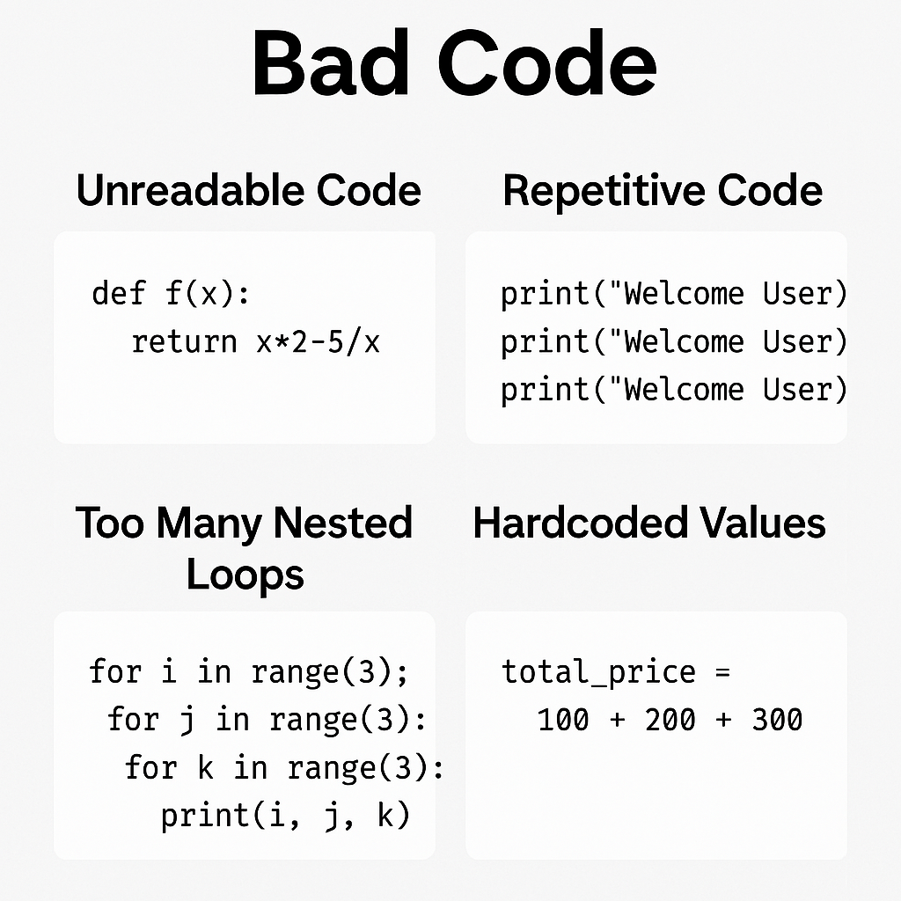
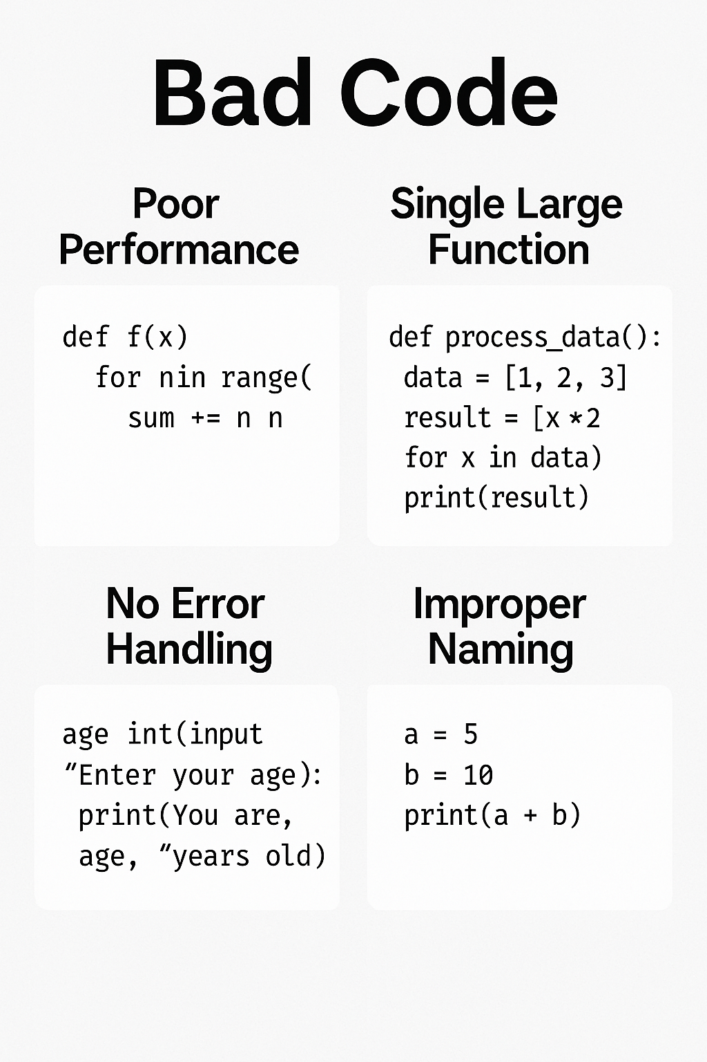
Some Examples of Bad Codes

Slide 8
Characteristics of good code
Readability – Clear, well-structured, and easy to understand.
Maintainability – Easy to modify, update, and debug.
Modularity – Divided into small, reusable functions and components.
Proper Naming Conventions – Meaningful variable and function names.
DRY (Don’t Repeat Yourself) – Avoid redundant code by using functions.
KISS (Keep It Simple, Stupid) – Write simple, straightforward solutions.
Proper Error Handling – Gracefully manage exceptions and failures.
Performance Optimization – Write efficient and scalable code.
Comments & Documentation – Explain why something is done, not just how.
Consistent Formatting – Follow coding standards like PEP 8 for Python.

Slide 9
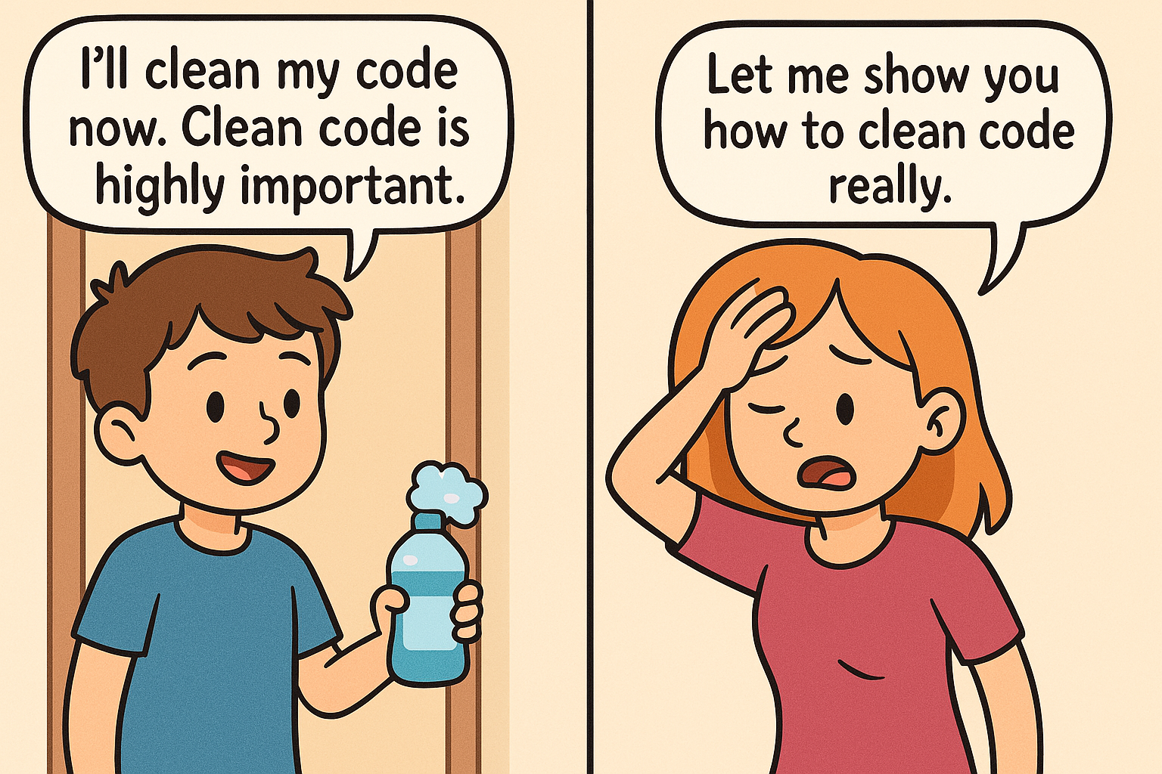
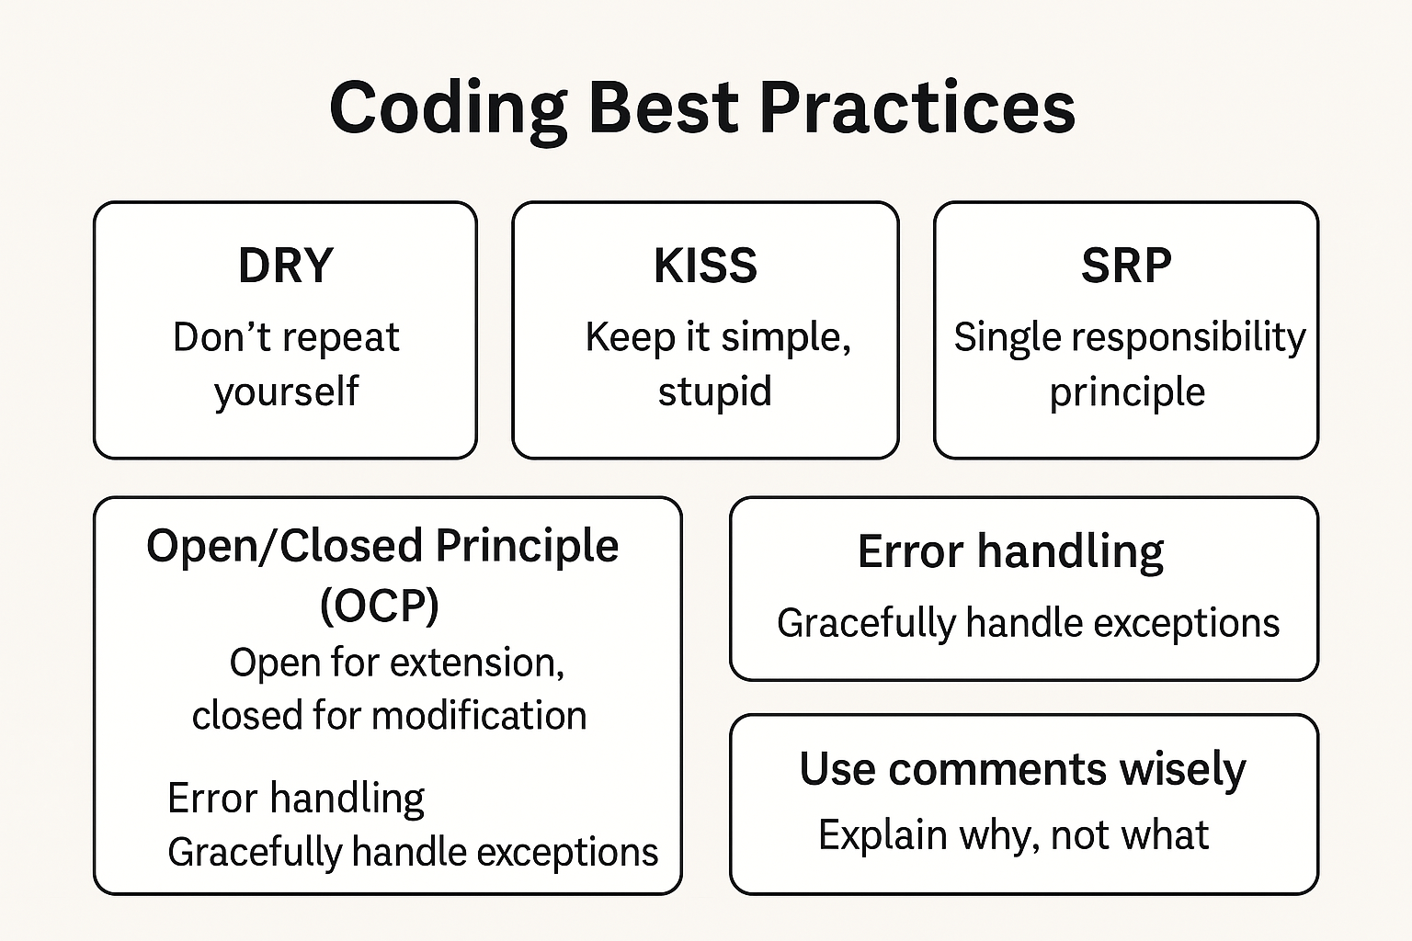
Coding Best Practices

Slide 10
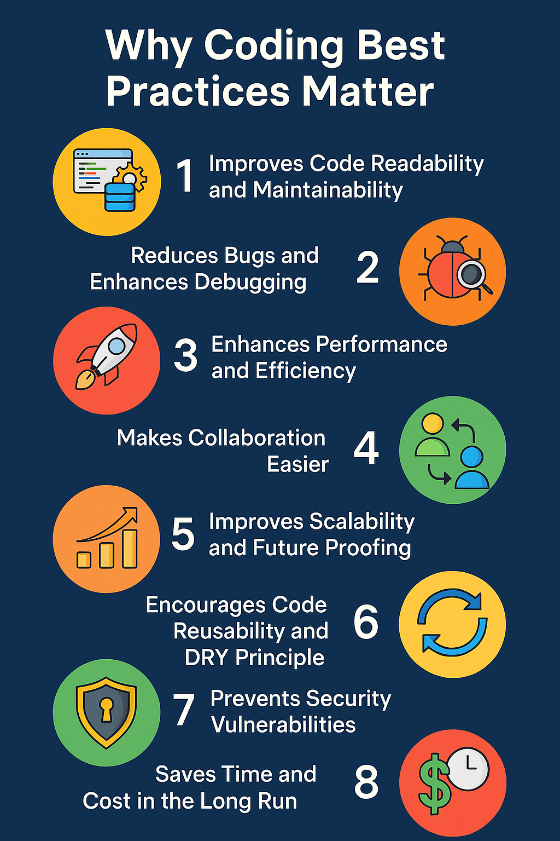
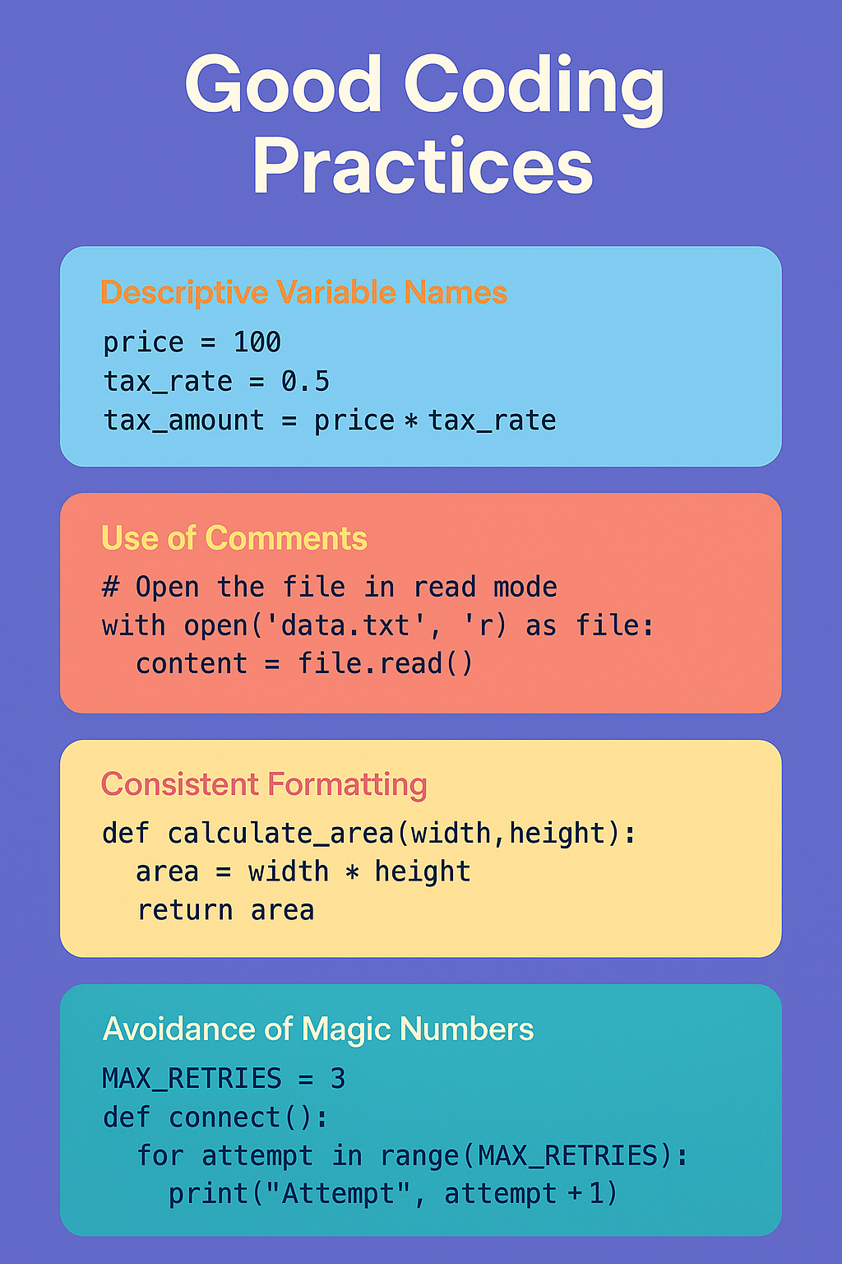

Slide 11
Example -1
BAD CODE
price1 = 100
price2 = 200
final_price1 = price1 + (price1 * 0.18)
final_price2 = price2 + (price2 * 0.18)
print("Final Price 1:", final_price1)
print("Final Price 2:", final_price2)
GOOD CODE
def calculate_final_price(price, tax_rate=0.18):
return price + (price * tax_rate)
price1 = 100
price2 = 200
final_price1 = calculate_final_price(price1)
final_price2 = calculate_final_price(price2)
print("Final Price 1:", final_price1)
print("Final Price 2:", final_price2)
Why code is bad
Code Duplication (DRY Principle Violation)
The formula for calculating the final price is repeated twice.
If the tax rate (0.18) changes, you will need update it in multiple places, increasing the risk of errors.

Slide 12
Example -2
BAD CODE
a = 50000
b = 10
c = (a * b) / 100
d = a + c
print(d)
GOOD CODE
def calculate_salary(base_salary, bonus_percentage):
"""Calculates the final salary after adding the bonus."""
bonus = (base_salary * bonus_percentage) / 100
final_salary = base_salary + bonus
return final_salary
base_salary = 50000
bonus_percentage = 10
final_salary_1 = calculate_salary(base_salary, bonus_percentage)
print(“Final salary is ” , final_salary)
Why above code is Good
Descriptive Variable names: make clear what each variable means.
Encapsulated Logic in a Function – The salary calculation is reusable, avoiding repetition hence scalable.
Clear Output with Context – Now we know exactly what’s being printed.
Why above code is bad
Unclear Variable names a, b, c, d
No Explanation in Output: The prints just show numbers without context.
Not Scalable: If we need to calculate for multiple values, it becomes messy.

Slide 13
Example -3
BAD CODE
age = int(input("Enter your age: "))
print("You are", age, "years old")
GOOD CODE
def get_valid_age():
"""Asks the user for a valid age and ensures correct input."""
while True:
try:
age = int(input("Enter your age: "))
if age <= 0:
print("Age must be a positive number. Please try again.")
else:
return age # Valid input, return it
except ValueError:
print("Invalid input! Please enter a valid number.")
Why above code is bad
No Input Validation – If the user enters a non-numeric value (like "twenty"), the program crashes.
No Handling for Negative or Unrealistic Ages
No Re-Prompting – If an invalid input is entered, the program should ask again instead of crashing.
Why above code is good
No crashes on invalid input
Input validation

Slide 14
Example - 4
BAD CODE
numbers = [1, 2, 3, 4, 5]
squared_numbers = []
for num in numbers:
squared_numbers.append(num ** 2)
print(squared_numbers)
GOOD CODE
numbers = [1, 2, 3, 4, 5]
squared_numbers = [num ** 2 for num in numbers]
print(squared_numbers)
Why above code is bad
The loop is unnecessarily long and inefficient.
Appending elements one by one to a list could be optimized.
Why above code is good
Use list comprehensions for a cleaner approach.

Slide 15
Example -5
BAD CODE
def get_access(role):
if role == "admin":
return "Full Access"
elif role == "editor":
return "Edit Access"
elif role == "viewer":
return "Read-Only Access"
else:
return "No Access"
GOOD CODE
ACCESS_LEVELS = {
"admin": "Full Access",
"editor": "Edit Access",
"viewer": "Read-Only Access",
}
def get_access(role):
return ACCESS_LEVELS.get(role, "No Access")
Why above code is bad
Too many if-else conditions making it harder to read and maintain.
Why above code is good
cleaner Completely removes Instead of multiple conditions, we use a dictionary lookup.
More scalable – Adding new roles is just adding a new key-value pair.

Slide 16
Example -6
BAD CODE
def process_text():
text = "hello world"
# Step 1: Convert to uppercase
text = text.upper()
# Step 2: Replace spaces with underscores
text = text.replace(" ", "_")
print(text)
process_text()
GOOD CODE
def to_uppercase(text):
return text.upper()
def replace_spaces(text):
return text.replace(" ", "_")
text = "hello world"
text = to_uppercase(text)
text = replace_spaces(text)
print(text)
Why above code is bad
Too much happening in one function - Converting case, replacing spaces
Not reusable – If we need the uppercase transformation elsewhere, we have to rewrite it.
Why above code is good
Smaller, focused functions – Each function does only one thing.
More reusable – If we need uppercase conversion elsewhere, we can reuse to_uppercase()
Easier to read – Each step is clearly separated.

Slide 17
Example -7
BAD CODE
matrix = [[1, 2, 3],
[4, 5, 6],
[7, 8, 9]]
squared_matrix = []
for row in matrix:
squared_row = []
for num in row:
squared_row.append(num ** 2)
squared_matrix.append(squared_row)
print(squared_matrix)
GOOD CODE
def square_numbers(row):
return [num ** 2 for num in row] # A single level of looping
matrix = [
[1, 2, 3],
[4, 5, 6],
[7, 8, 9]
]
squared_matrix = [square_numbers(row) for row in matrix] # Cleaner approach
print(squared_matrix)
Why above code is bad
Unnecessary Nested Loops
Manual List Appending
Why above code is good
Uses List Comprehension (More Readable & Pythonic)
Separates Concerns with a Function

